Slide 1
Linear Algebra: What are we going to learn?
李宏毅
Hung-yi Lee

Slide 2

What are we going to learn?
A system of linear equations (多元一次聯立方程式)
coefficients
variables
constant term
A linear equation
$$\begin{matrix}\begin{matrix}2 & x_{1}\end{matrix} & \begin{matrix}+3 & x_{2}\end{matrix} & \begin{matrix}+5 & x_{3}\end{matrix} \\ \begin{matrix}3 & x_{1}\end{matrix} & \begin{matrix}+1 & x_{2}\end{matrix} & \begin{matrix}−1 & x_{3}\end{matrix} \\ \begin{matrix}−2 & x_{1}\end{matrix} & \begin{matrix}+1 & x_{2}\end{matrix} & \begin{matrix}+1 & x_{3}\end{matrix}\end{matrix}$$
$$\begin{matrix}= & 5 \\ = & 2 \\ = & 1\end{matrix}$$
a system of linear equations
I believe you know how to solve it.
Notes:
這門課教什麼？可以用一句話
要不要講呢？
所有"未知數"的冪次項為一次。

Slide 3
What are we going to learn?
A system of linear equations (多元一次聯立方程式)
m equations
n variables
In this course, m and n can be large
Notes:
If you can't solve many equations simultaneously then you can't solve commercial scale problems
At some point in a lot of interesting places, people get to a certain step and then say "And then it's just linear algebra from there".
questions like "How can I prepare for an interview?" are often going to boil down to "Brush up on your linear algebra".

Slide 4
What are we going to learn?
Solving a system of linear equations
Independent
span
rank
Does it have solution?
Does it have unique solution?
How to find the solution?
Determinants (行列式)
Approximate Solution
Beyond 3 X 3
Different view from high school
Notes:
Higher dimension

Slide 5
Linear System
x₁
System
y₁
x₂
y₂
We use a system of linear equations to describe a linear system
What is system?
function, transformation, operator
A system has input and output
E.g. Speech Recognition System: The input is audio signals, and the output is recognition results.
E.g. Siri: You say “Hi, Siri”, it reply “What can I do for you?”
E.g. Communication system
Can have multiple inputs and outputs
Notes:
Simply consider it as a function
E.g. Input: population last year, output: population this year
E.g. rotation
MIMO

Slide 6
Linear System
Linear system have two properties
1. Persevering Multiplication
2. Persevering Addition
Linear
System
Linear
System
x
y
kx
ky
x₁
Linear
System
y₁
x₁+x₂
Linear
System
y₁+y₂
x₂
Linear
System
y₂

Slide 7
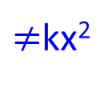
Linear System
System
x
x²
Linear system have two properties
1. Persevering Multiplication
2. Persevering Addition
Linear
System
Linear
System
x
x²
kx
k²x²
$≠$kx²
$$x_{1}$$
Linear
System
$${\left(x_{1}\right)}^{2}$$
$$x_{1}+x_{2}$$
Linear
System
$${\left(x_{1}+x_{2}\right)}^{2}$$
Linear
System
$$x_{2}$$
$${\left(x_{2}\right)}^{2}$$
$$≠{\left(x_{1}\right)}^{2}+{\left(x_{2}\right)}^{2}$$

Slide 8
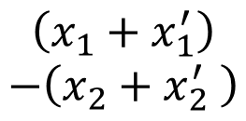
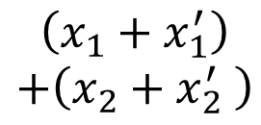
Linear System
$$x_{1}$$
System
$$x_{1}+x_{2}$$
$$x_{2}$$
$${x_{1}−x}_{2}$$
Two properties
1. Persevering Multiplication
2. Persevering Addition
$$x_{1}$$
System
$$x_{1}+x_{2}$$
$$kx_{1}$$
System
$$kx_{1}+kx_{2}$$
$$x_{2}$$
$${x_{1}−x}_{2}$$
$${kx}_{2}$$
$${kx_{1}−kx}_{2}$$
$$x_{1}$$
System
$$x_{1}+x_{2}$$
$$\left(x_{1}+x_{1}^{′}\right)$$
$$+\left(x_{2}+x_{2}^{′} \right)$$
$$x_{2}$$
$$x_{1}+x_{1}^{′}$$
$${x_{1}−x}_{2}$$
System
$$x_{1}^{′}$$
System
$$x_{1}^{′}+x_{2}^{′}$$
$$x_{2}+x_{2}^{′}$$
$$\left(x_{1}+x_{1}^{′}\right)$$
$$−\left(x_{2}+x_{2}^{′} \right)$$
$$x_{2}^{′}$$
$${x_{1}^{′}−x}_{2}^{′}$$

Slide 9
Linear System v.s. System of Linear Equations
?
$$x_{1}$$
Linear
System
$$b_{1}$$
$$x_{2}$$
$$b_{2}$$
……
……
$$x_{n}$$
$$b_{m}$$

Slide 10
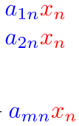
$$1$$
Linear
System
$$a_{11}$$
$$0$$
Linear
System
$$a_{12}$$
$$0$$
Linear
System
$$a_{1n}$$
$$0$$
$$a_{21}$$
$$1$$
$$a_{22}$$
$$0$$
$$a_{2n}$$
……
……
……
……
……
……
……
$$0$$
$$a_{m1}$$
$$0$$
$$a_{m2}$$
$$1$$
$$a_{mn}$$
$$x_{1}$$
$$0$$
$$0$$
$$0$$
$$x_{2}$$
$$0$$
……
……
……
……
……
……
……
$$0$$
$$0$$
$$x_{n}$$
$$x_{1}$$
Linear
System
$$x_{2}$$
……
$$x_{n}$$
A linear system is described by a system of linear equations

Slide 11
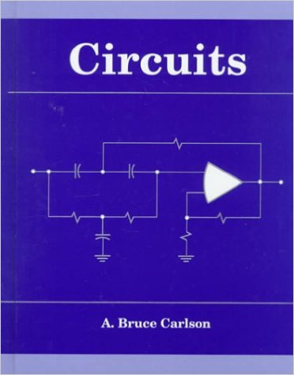
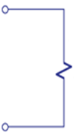
Applications
Most system are (assumed to) be linear
Input: voltage source, current source
Linear
output: voltage and current on the load (燈泡、引擎)
Circuit
+
-
input
output
(大二上)
Linear System
Notes:
Desing filtering

Slide 12
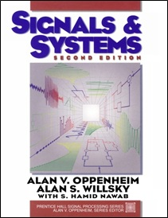
Applications
Most system are (assumed to) be linear
Communication System
Linear
Channel
Transmitter
Receiver
Linear System
(大二下)
Notes:
像無線通訊訊號在介質中的傳播就可以用線性系統來模擬

Slide 13
Applications
坪數
房價
分析
位置
價格
Machine Learning
E.g. Prediction
…….
Linear system
今天天氣
氣象
預報
昨天天氣
明天天氣
…….
Linear system
股票
分析
今天行情
明天行情
Linear system

Slide 14
Applications
We will learn EigenXXXXX
Input equals to output
Output is zero
$$x_{1}$$
Linear
System
$$x_{1}$$
$$x_{1}^{′}$$
Linear
System
$$0$$
$$x_{2}$$
$$x_{2}$$
$$x_{2}^{′}$$
$$0$$
……
……
……
……
$$x_{n}$$
$$x_{n}$$
$$x_{n}^{′}$$
$$0$$
Filter
Notes:
Eigenvalues and the Collapse of the Tacoma Narrows Bridge
https://en.wikipedia.org/wiki/Tacoma_Narrows_Bridge
Find the picture here
http://hubpages.com/education/What-the-Heck-are-Eigenvalues-and-Eigenvectors

Slide 15
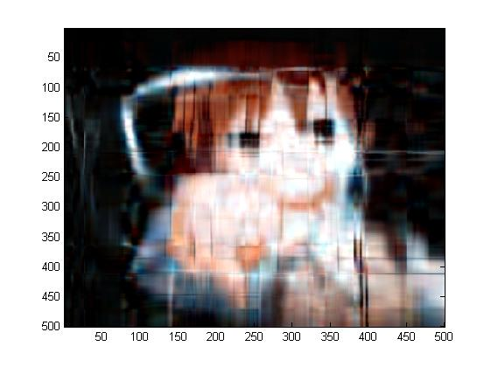
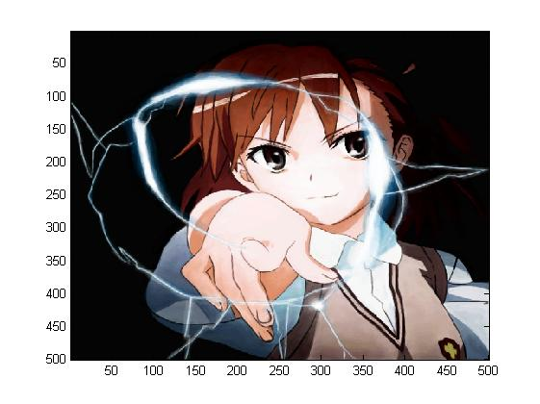
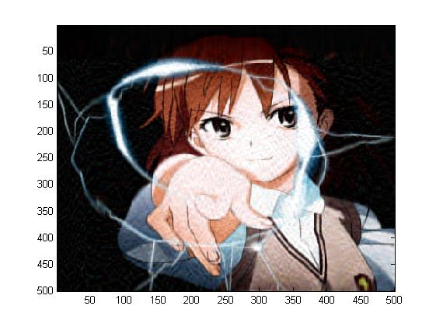
Applications – Image Compression
壓縮比: 25
壓縮比: 12.5
壓縮比: 5
壓縮比: 2.5
原圖
Notes:
10 20 50 100

Slide 16
Linear Algebra is Important
Notes:
https://lab.mikuru.tw/CQG/

